Slide 1


Crescent Consulting and Development operates from Mooroonga, stolen land of the Yuggera people. We pay respect to elders past present and emerging. Sovereignty of this land was never ceded. It always was and always will be aboriginal land.

Slide 2

A View of Their History, a Plan for Their Future Young people centred Intervention for Domestic and Family Violence

Slide 3

Working with young people using or experiencing DFV to build safety and inspire accountability – The journey from early intervention to prevention and beyond

Slide 4

Young peoples experience and use of intimate partner violence,
The drivers. How does their history and place in this world interact with the likelihood?
How do we identify the presence of intimate partner abuse?
How do we as practitioners respond in ways that improve safety for victims?
How do we as practitioners respond in ways that encourage engagement, trauma informed accountability and reflection, without collusion?
Let's Talk About

Slide 5
DATA
AIHW: 34% of children and young people presenting alone for homelessness services have experienced domestic and family violence.
The Australian Child Maltreatment Study found that 43.8 per cent of young people aged 16 to 24 years had experienced exposure to domestic violence.
NCAS 2021: 89% of young people (aged 16-20) years who had used violence in the home reported that they had experienced child abuse.
AIHW 2020 ‘Australia’s Children’ report: Children and young people who are exposed to domestic and family violence normalise violence as a coping or conflict resolution strategy.
NCAS 2021: In 2021 compared to both 2009 and 2013, young people had a lower understanding that domestic violence is gendered, with men being the main perpetrators and women being the most likely to experience fear or physical harm as a result. However, young men and young women both demonstrated a decline since 2013 in understanding of the gendered nature of domestic violence.
Setting the Scene

Slide 6
DRIVERS
Our Watch: Gender Based Violence is driven by – Condoning of violence against women, - Rigid stereotyping and dominant forms of masculinity, - Controlling attitudes towards women's decision making and independence
Cultural influences such as Andrew Tate, Red Pill culture and the Manosphere have impacted young people's views on gender-based violence, gender equality and masculinity
These have been collected and portrayed by mainstream media – Inside the Manosphere, Adolescence etc
NCAS 2021: Young men (48%) were significantly more likely than young women (25%) to agree that women exaggerate how unequally women are treated in Australia. Young men also lagged behind young non-binary respondents in their rejection of gender inequality and rejection of some aspects of violence against women.
The experience of LGBTQIASB+ young people in both family and intimate partner relationships is informed by power dynamics founded in patriarchal relationship norms
Setting the Scene

Slide 7





Resistive & Reactive Violence
Forms
of
Accountability
Minimisation, Denial & Blame (MDB)
Refining Perceptions
Coercive Control
Trauma Informed
Accountability
Mutualisation
Impression
Curation

Slide 8
Coexisting Complexities
Domestic Violence Protection Orders
The impact of technology and normalisation of location tracking
The concept of enthusiastic consent beyond sex
AOD including substance co-dependency
Trauma bonding – especially for young people with precarious living condition and ‘shared’ histories, and of course,
Housing precarity
All of these can be a barrier to safety and/or autonomy

Slide 9
Finding the Future
How and why to engage with young people on the topic of their relationship and use, or experience of abuse

Slide 10

Consider
What safety does this relationship provide VS what risk. Especially for homeless young women, queer and Trans feminine people, PWD, sex workers
What are the systemic and social stigmas and disadvantages that this YP faces?
How does their partner react/behave if you try and speak with them alone?
Safety planning VS enforcing separation
Discuss
'What did you hope for in your idea of being in a relationship?
What does a good relationship look like?’
‘What does abuse look like?’
‘What does the future look like?’
How do these things match up, or not with your relationship with…
Family history of DFV 'How do you think this has affected your expectations around relationships?
Victim Survivors/Person Experiencing Violence

Slide 11
Consider
Shame, its benefits and pitfalls incl pre-existing MH issues
What are the privileges and entitlements that this YP has in comparison to their partner?
How do they react if a worker speaks to partner alone?
Their description of a feeling/emotion vs an action
Discuss
'What did you hope for in your idea of being in a relationship?
What does a good relationship look like?’
What does a good partner act like?
‘What does abuse look like?’
‘What does the future look like?’
‘Who do YOU want to be in your relationship?’
Family history of DFV 'How do you think this has affected your ability to have/behave respectfully in relationships?
Person Using Violence/Abuse

Slide 12
Observe
Is there an ongoing pattern beyond outbursts and ‘elevated incidents’?
Are there high levels of unfounded sexual jealousy demonstrated?
Is one person fixated on blaming, putting down, or shaming the other person to you?
Have other young people told you of behaviours from one of the couple that indicate abuse?
Upon analysis, do you believe that there is abuse occurring by one person against the other in this relationship?
Have you conferred with a colleague who knows these young people well or has spent time with one or both of them?
The Relationship Dynamics

Slide 13
What equips us
to better respond to risk, increase safety and foster accountability?

Slide 14
ISR - Integrated Service Response
CRASF risk assessment and safety planning tools | Department of Families, Seniors, Disability Services and Child Safety
Flow diagrams for information sharing under Part 5A of the Domestic and Family Violence Protection Act 2012 ,
Across systems, across safety –
De-Siloing our Sectors

Slide 15
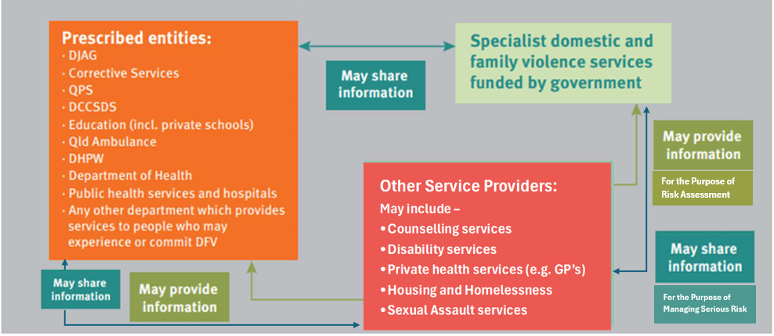
Risk Assessment:
Threshold – If the entity reasonably believes a parson fears or is experiencing DFV, information can be shared IF IT IS RELEVANT to assessing whether there is a serious threat to the life, heath or safety of a person because of domestic or family violence
Managing Serious Risk
Threshold – If the entity reasonably believes a parson fares or is experiencing DFV, information can be shared if it will help the other entity to lesson or prevent a serious threat to the life, health or safety of a person because of domestic violence
Across systems, across safety – De-Siloing our Sectors

Slide 16
RFI’s (Requests For Information) – develop an organisational policy, procedure and/or template
Establish links and connections with specialist services
Case note for safety, case note for accountability
Across systems, across safety –
De-Siloing Our Sectors

Slide 17
Modelling Primary Prevention
Approaches to the work within
Demonstrate different views of equality and ‘power’ for young people in every interaction they see
Model respect between different genders as workers. Consider who talks more, who interrupts, who listens, who backs the others' opinion and suggestions, who is the ‘carer’
Diverse workforces with women, queer, transfeminine and gender non-binary people including in senior positions

Slide 18

A Future Investment
We want the best for young people. Pro-actively investing in developing practice, strengthening responses and participating in collaboration opportunities increases safety from serious harm and from causing undoable harm.

Slide 19



Thank you
Questions?
belinda.cox@crescentconsulting.com.au

