Slide 1
The Stairway to Change Starts with Empathy, Courage, and Advocacy – Guiding Young People Towards Respect.
Presented By | Dave Kramer (BBehavSC | Hons, Psych)
Ambassador | Small Steps 4 Hannah | InnerBoy
Find me on LinkedIn: www.linkedin.com/in/davekramer | Follow me on Instagram: @_davekramer

Slide 2
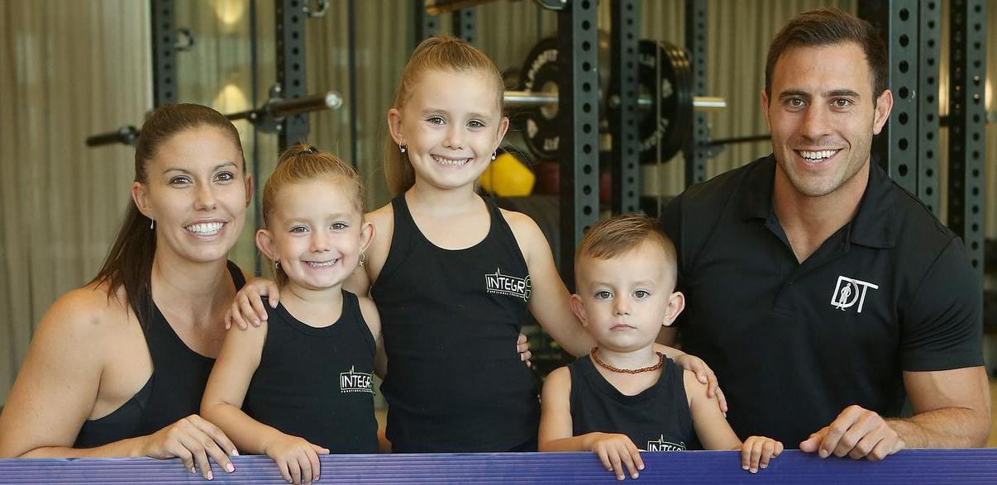
Find me on LinkedIn: www.linkedin.com/in/davekramer | Follow me on Instagram: @_davekramer

