Slide 1


Raising Queensland
March 2026

Slide 2


QCOSS acknowledges Aboriginal and Torres Strait Islander people as the original inhabitants of Australia and recognises these unique cultures as part of the cultural heritage of all Australians. We pay respect to the Elders of this land; past and present.
Notes:
QCOSS acknowledges the [INSERT NAME] people, Traditional Custodians of the land on which we gather today. We pay our respects to their Elders, past and present.
QCOSS acknowledges the historical injustice and ongoing impact of colonisation and dispossession on First Nations Peoples.
We are committed to reconciliation, self-determination, and opportunity for First Nations Peoples as integral steps in achieving equality, opportunity and well-being for all Queenslanders.
First Nations Peoples’ knowledge and leadership is essential to building fair and inclusive communities.

Slide 3
What we heard from the sector
What was the scope of the research?

Slide 4


Prof. Karen Healy AM
Dr Laura Simpson Reeves
Dr Jemma Venables
Dr Caitlin Nathanson
Generously funded by Hand Heart Pocket

Slide 5
Research question:
How can the service system be improved to achieve better outcomes for vulnerable children and families?
Raising Queensland Report
Notes:
Report p. 2:
1.1.2 Research focus
This research project sought to understand the challenges currently facing children and young people (up to 18 years), their families, and their communities in Queensland, and to identify opportunities to better support them. QCOSS supports policies that promote equity of access to services for vulnerable children and families. While recognising that all children, young people, and their families require support throughout their lives, the prescribed focus of the research was to identify how the Queensland social service system can be improved to achieve better outcomes for vulnerable and disadvantaged children, young people, and their families. QCOSS posed the research question: How can the service system be improved to achieve better outcomes for vulnerable children and families? The focus of the research was on the key domains of health, housing, and education.
To help answer this question, the research team aimed to meet four objectives:
Understand the level and extent of unmet need for vulnerable and disadvantaged children and young people in Queensland with a particular focus on health, housing and education.
Identify, analyse, and critique current Queensland government policies regarding holistic responses to promote the social inclusion and wellbeing of vulnerable and disadvantaged children and young people with a particular focus on health, housing and education.
Gather and analyse stakeholders’ understanding of the opportunities and gaps that exist within the current system, with a focus on health, housing, and education.
Develop recommendations for holistic systems of reform to enable the delivery of services that provide foundational supports to vulnerable and disadvantaged children and families into adulthood.
The findings of this research report will inform QCOSS’ advocacy efforts in relation to children and young people over the next four years.

Slide 6

Research methods
Desktop policy review
Semi-structured interviews with key state government stakeholders
Focus groups with QCOSS member organisations
Focus group with young people

Slide 7

Analysis
ARACY has developed the ARACY Nest Wellbeing Framework (‘the Nest’), a wellbeing framework for children and young people acknowledging that wellbeing is multidimensional and interconnected
Material basics | Participating | Learning |Healthy Identity and culture |
Valued, loved and safe

Slide 8

Key points – Policy review
Wellbeing shaped by wide range of policies
Policies often view Queenslanders as homogenous cohort, focus on universal supports
Child and youth perspectives are frequently overlooked in key policies
Limited attention to negative effects of disadvantage and vulnerability on life outcomes
Where attention is given to children’s needs, framing is generally future focused

Slide 9
Key Points - Policy
Government and community sector can support families to care for children, create family-inclusive communities
Multi-dimensional responses attend to challenges of building and maintaining skilled workforce

Slide 10
Key points – Stakeholder perspectives
All agreed current resources and services are inadequate for equity of access for children and young people who experienced disadvantage

Slide 11
Key points - Children, Young people and their Families
Many subpopulations experience high levels of disadvantage (regional and remote, Aboriginal and Torres Strait Islander families)
Disparities in outcomes are well documented across housing, education, health
Gaps in reporting across domains of wellbeing
No consistent definition of vulnerable or disadvantaged
Improving wellbeing requires mix of universal
and targeted supports

Slide 12
Key points - Children, Young people and their Families
Most Australian children and young people are healthy, safe and well, but …

Slide 13
Key points – Stakeholder perspectives
Gaps in delivery are driven by systemic factors
Particularly affecting regional and remote areas
Addressing systemic factors requires investment at all levels
Schools, local community, government, etc.
Key needs identified:
Material basics
Earlier support
Holistic responses
Sustained collaboration
Evidence-informed approaches
Community-driven initiatives
Quality workforce
Choice

Slide 14
almost ONE Quarter of children In Queensland are meeting developmental goals by THE time They start SCHool
Over 10,000 families waiting for Social housing (more than 90% are Single Parent households)
Food insecurity is rising, with households cutting corners to feed themselves

Slide 15
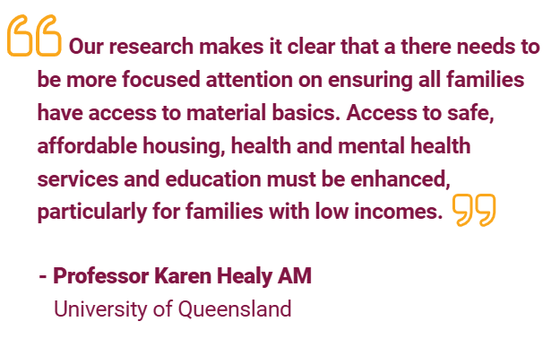


Slide 16
Key Points - Policy
Needs strong, consistent focus on material basics, especially safe and affordable housing
Provide equitable access to health services, education and training
Tailored services and supports are needed for children and families who experience the disadvantage to access the supports they need to thrive.
Strengthen capacity of the service system to provide culturally safe and responsive services

Slide 17

Policy priorities and recommendations
Develop multi-dimensional, whole of government Families Strategy
Shared vision of desired outcomes for children and families who experience disadvantage across all levels of government, NGO sector and philanthropy
Adopt the Nest Wellbeing Framework to guide holistic approach
Build sustainable workforce by increasing duration and adequacy of funding contracts
Support members of equity groups to undertake tertiary child and family studies

Slide 18



Slide 19

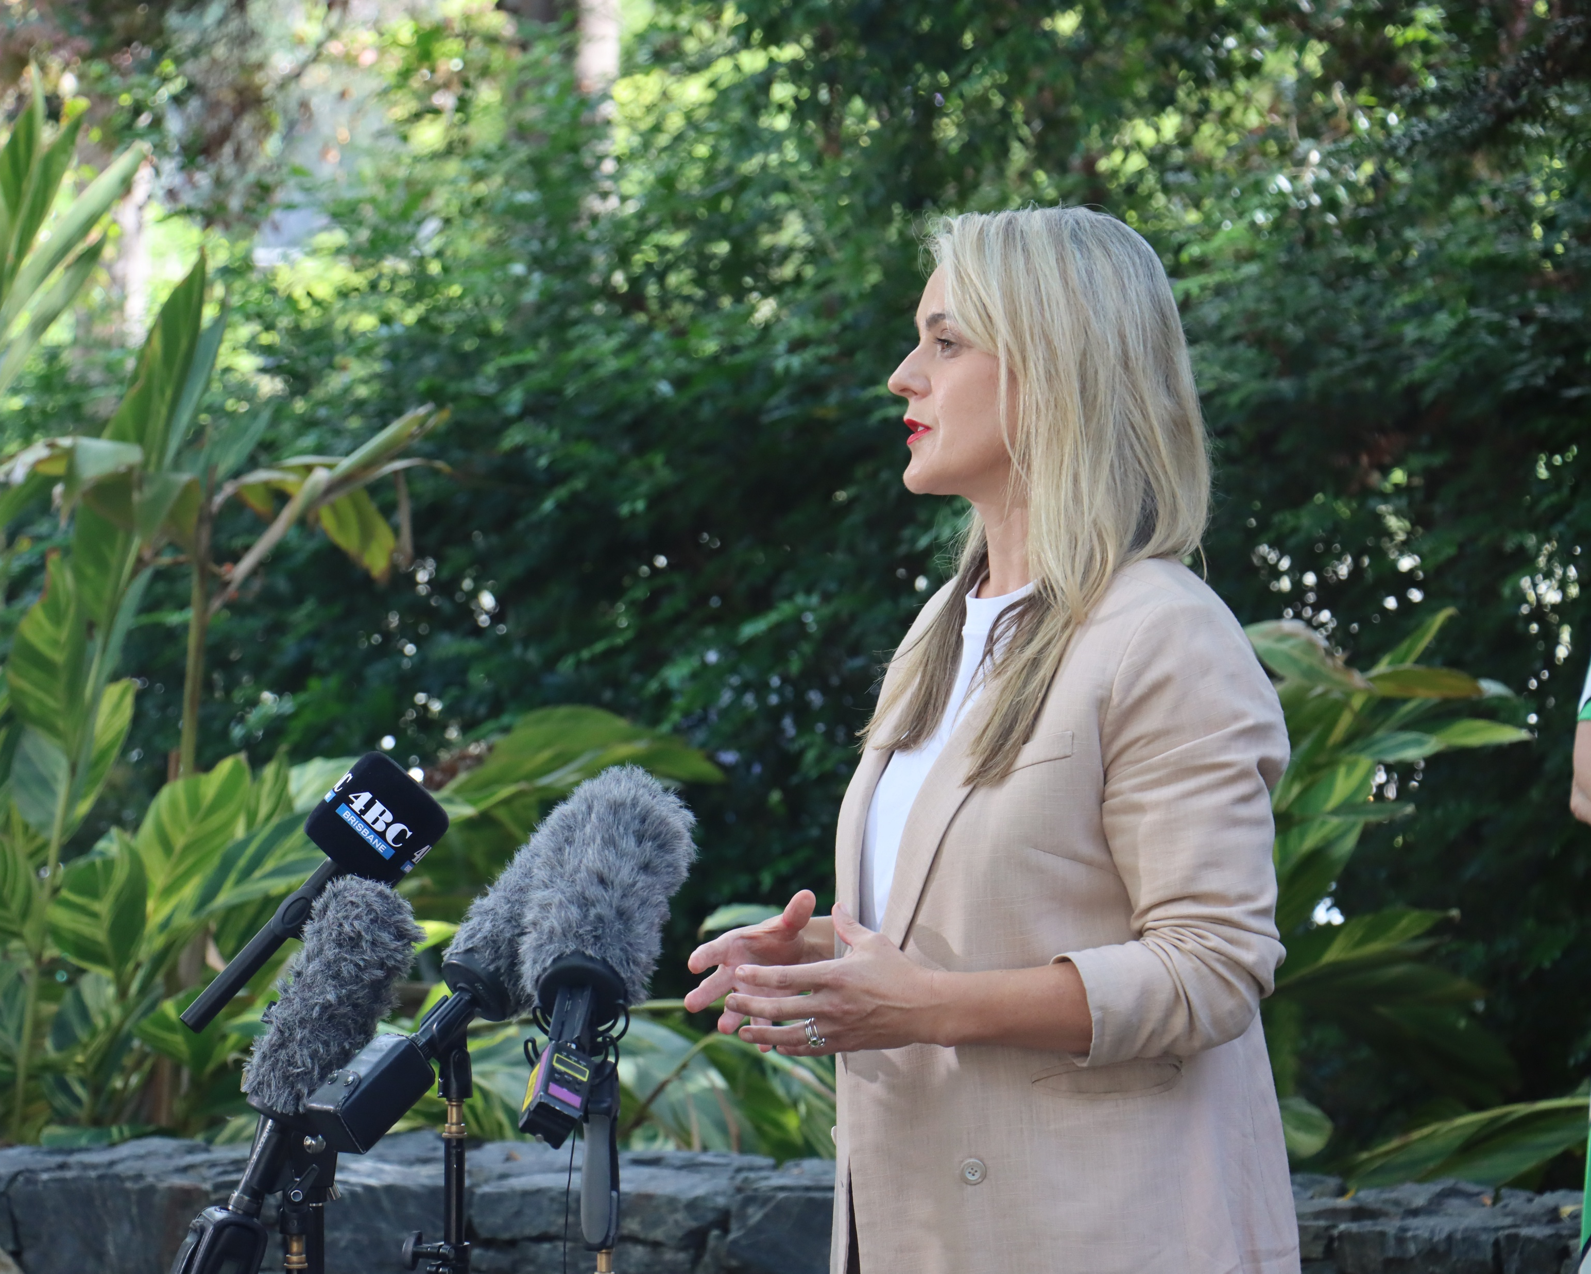
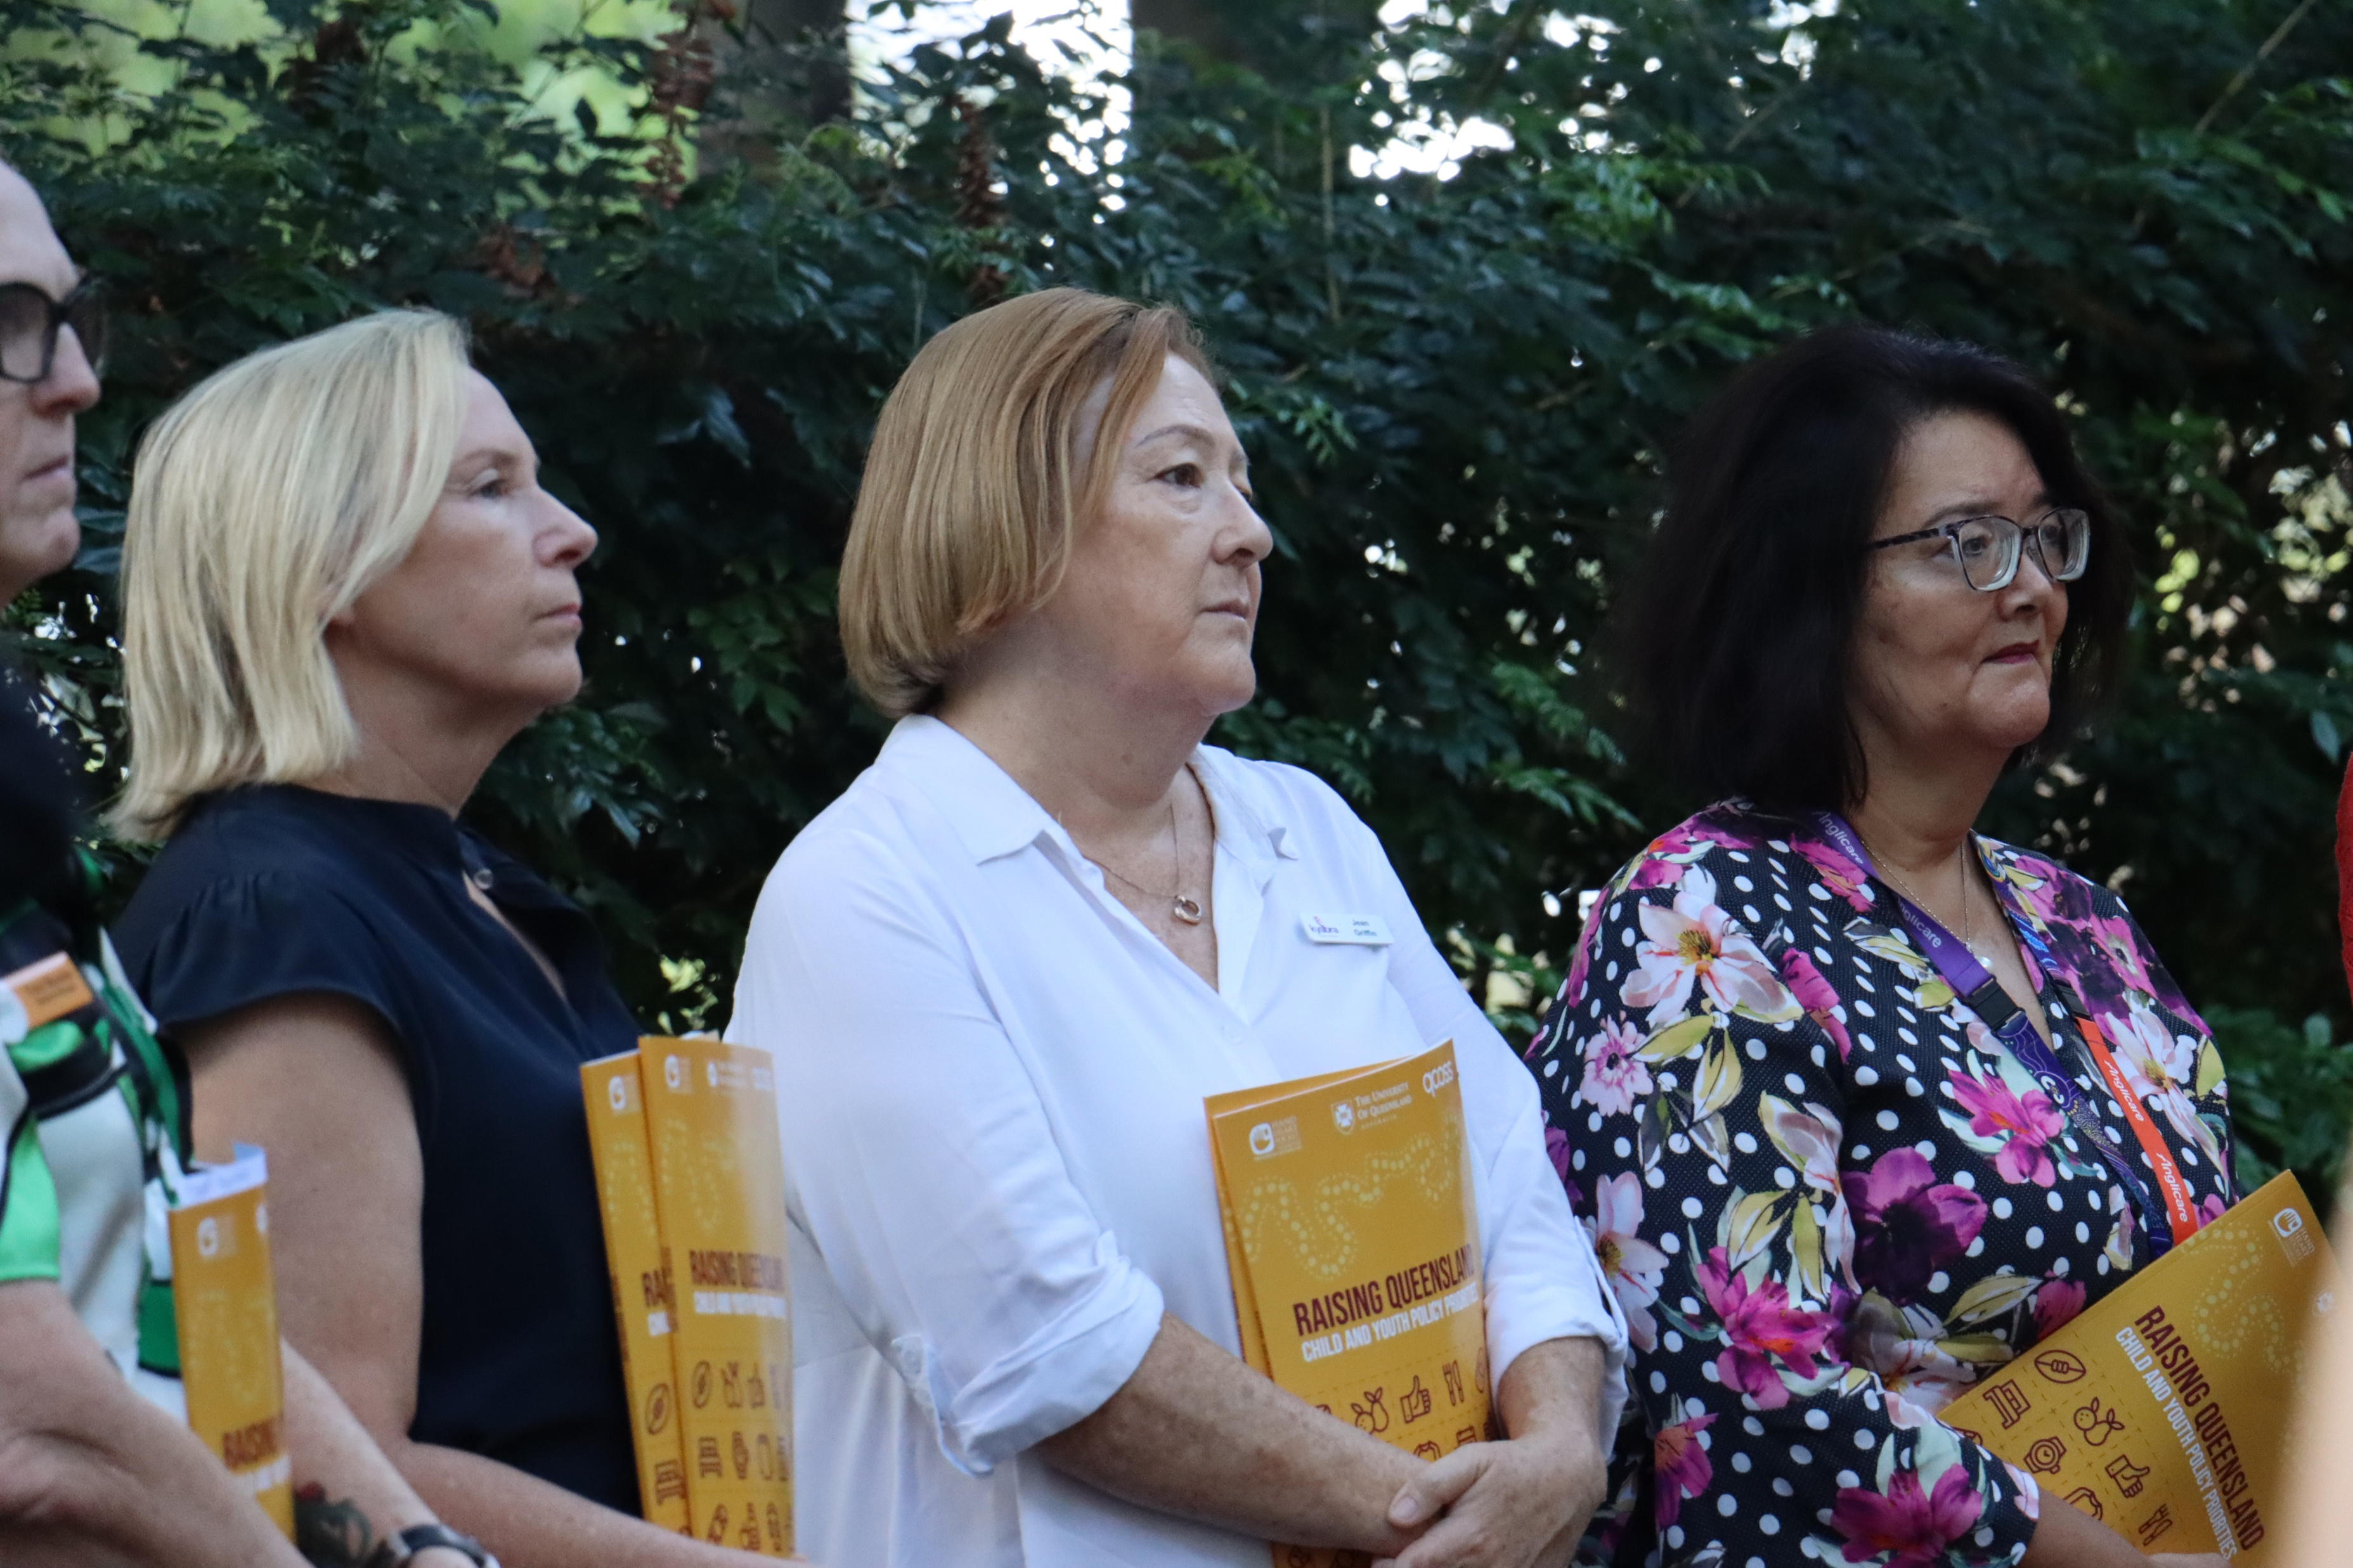


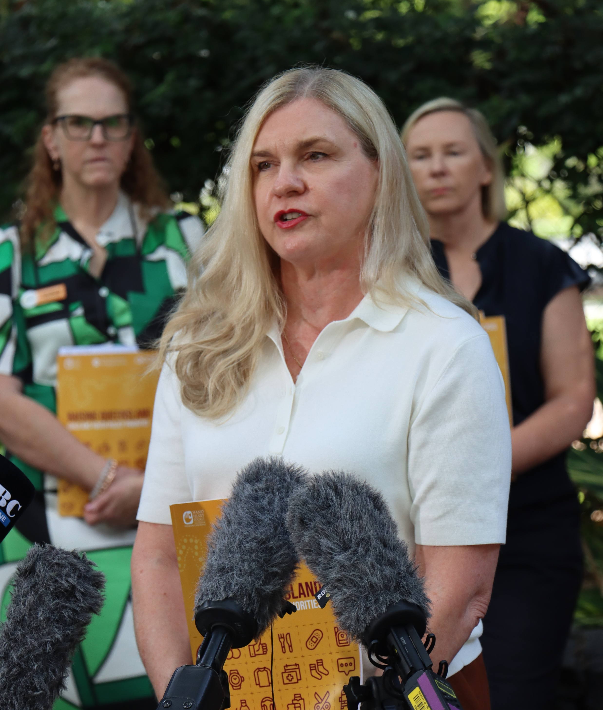

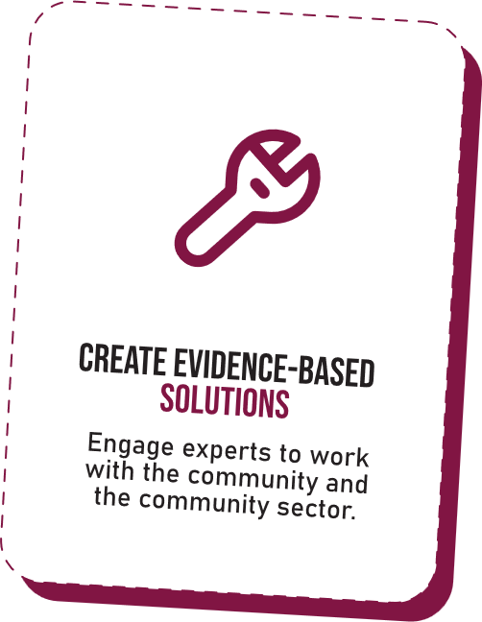
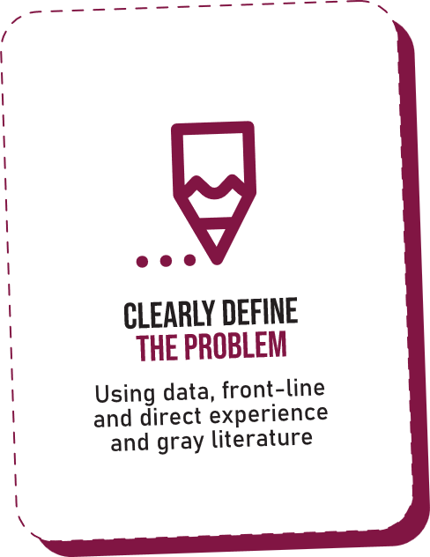
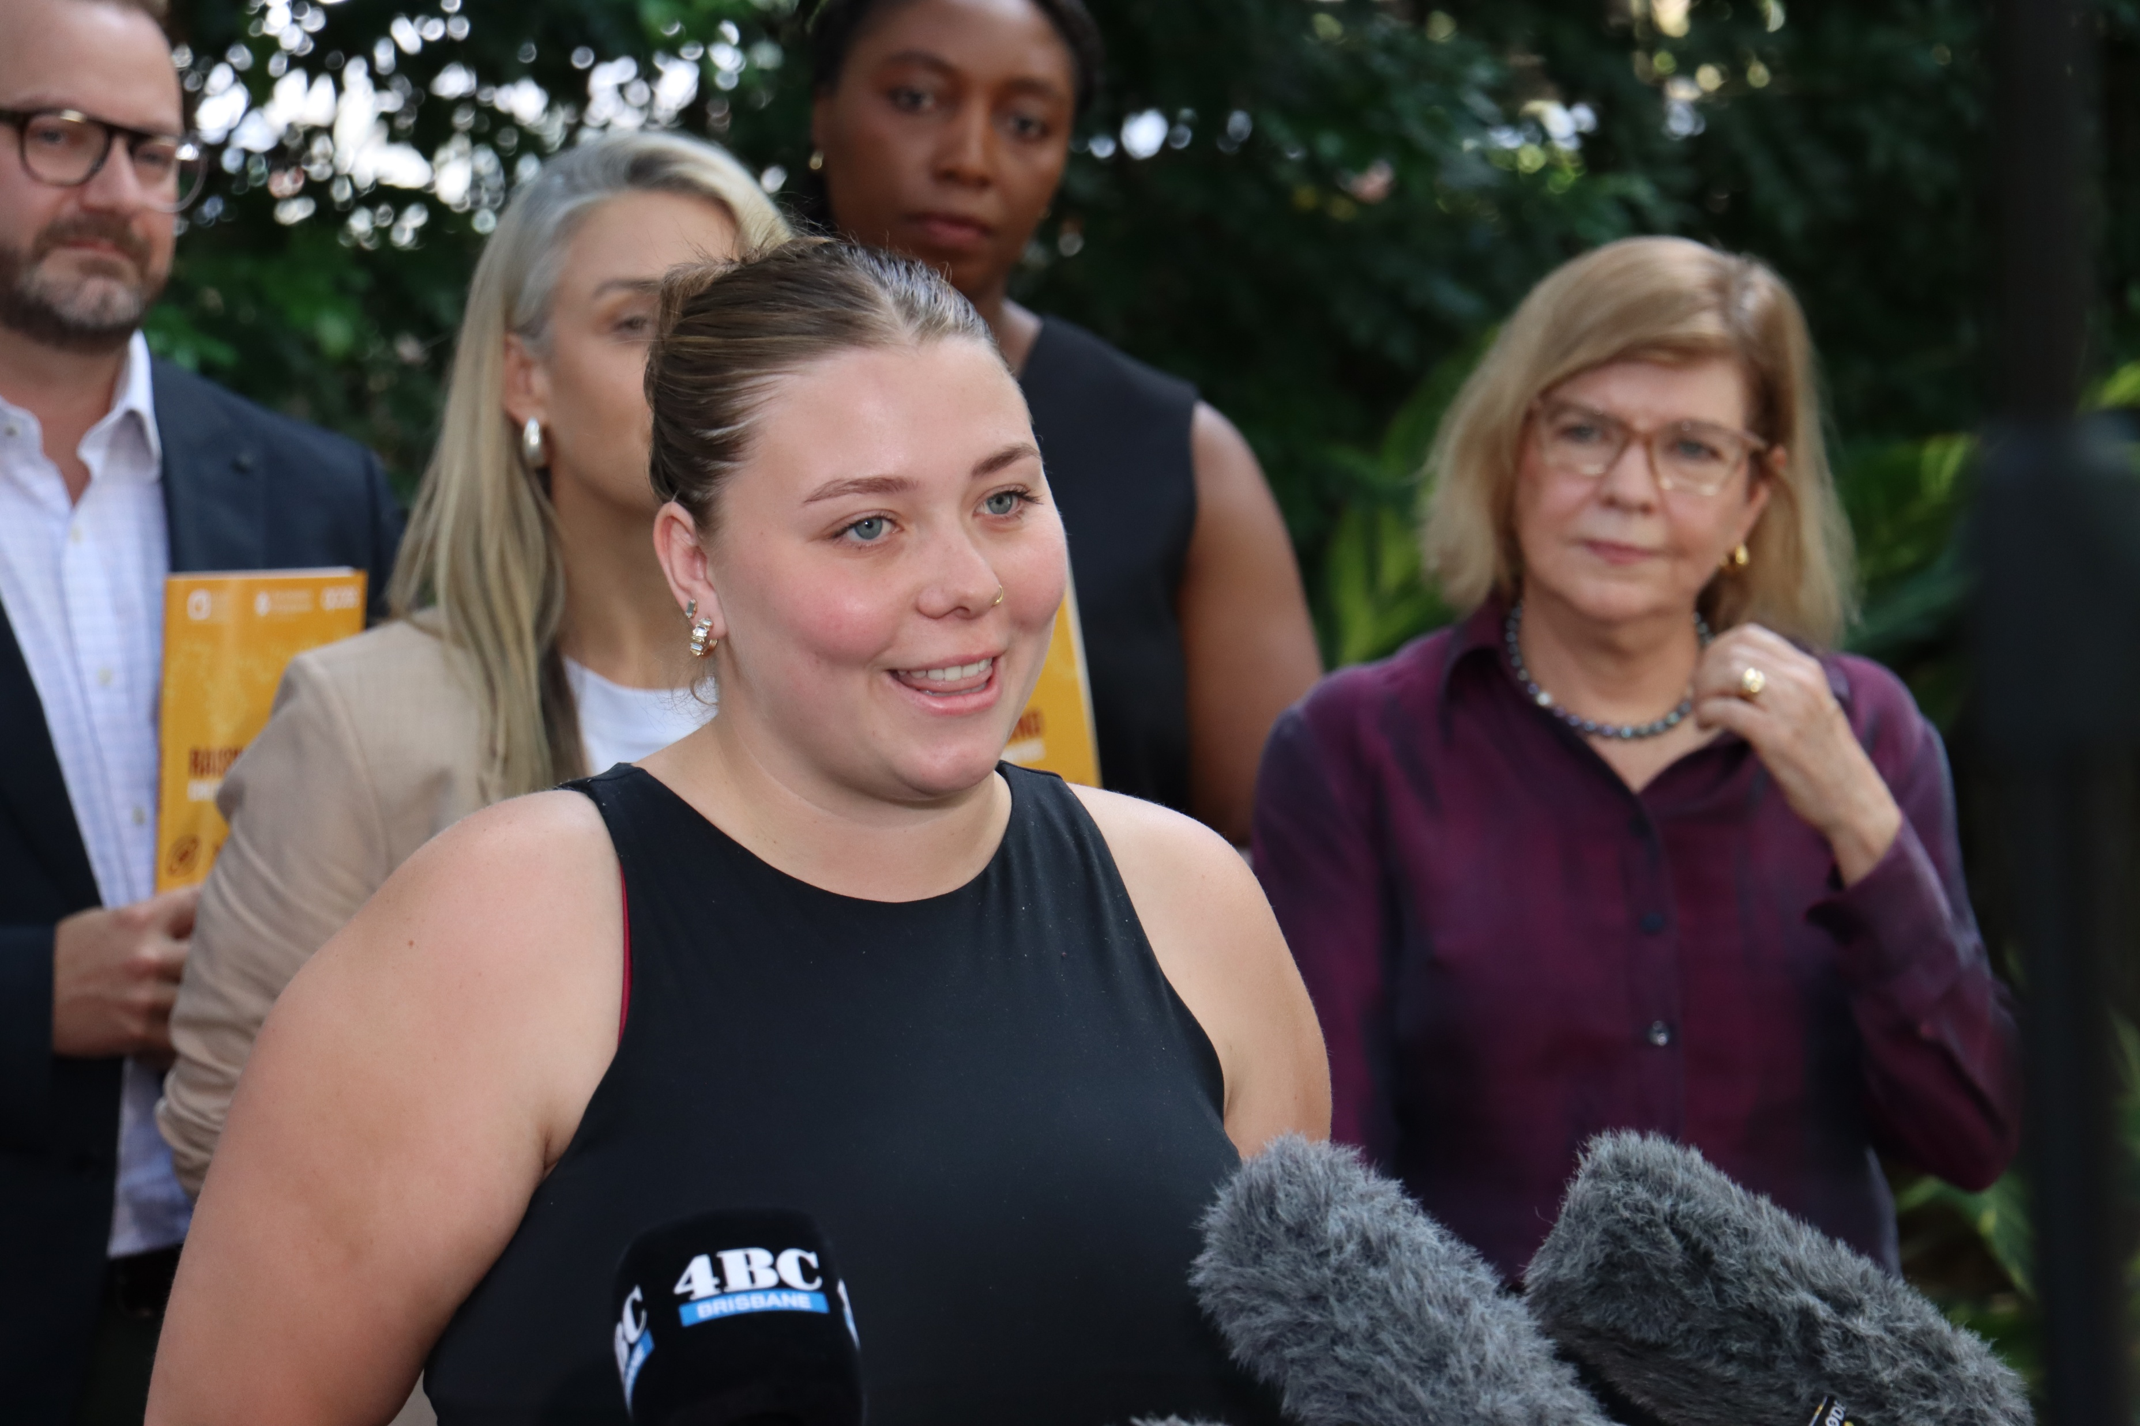
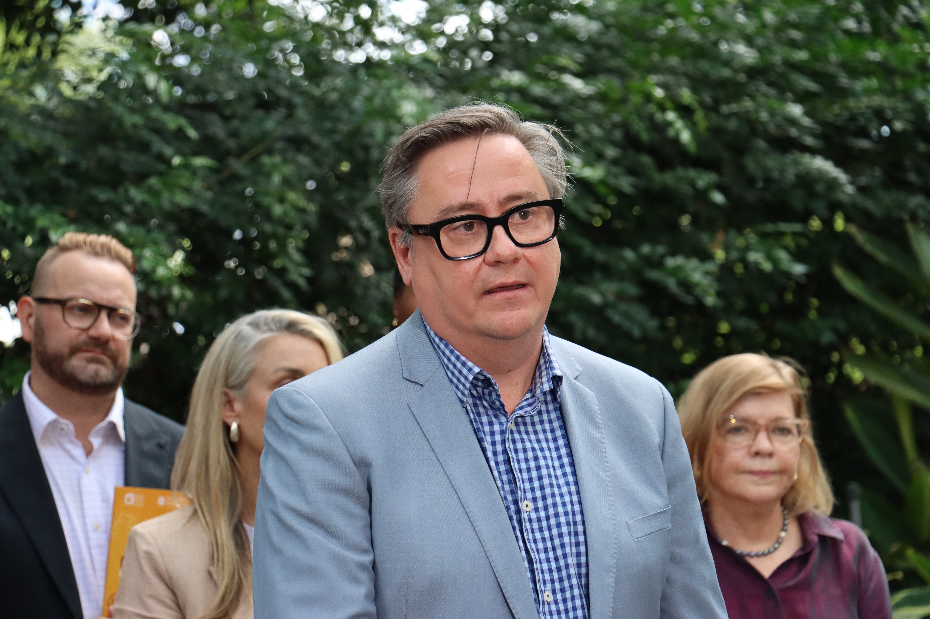
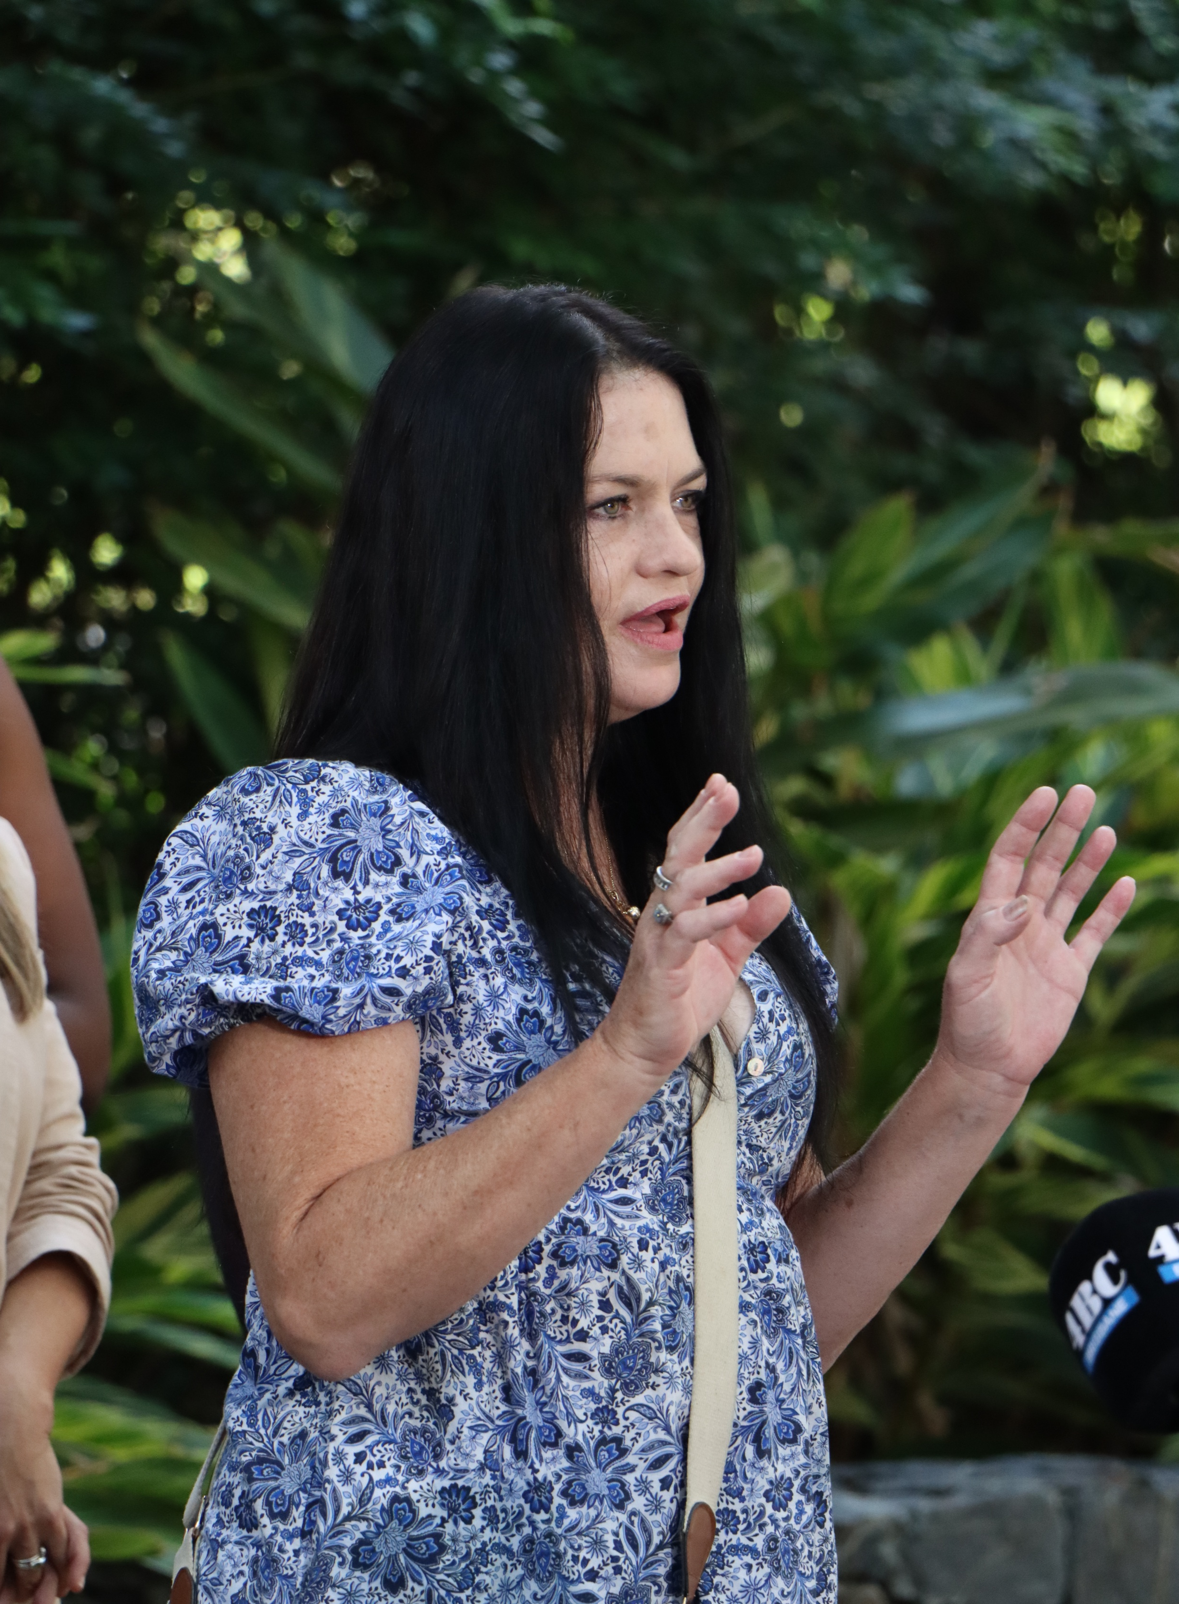

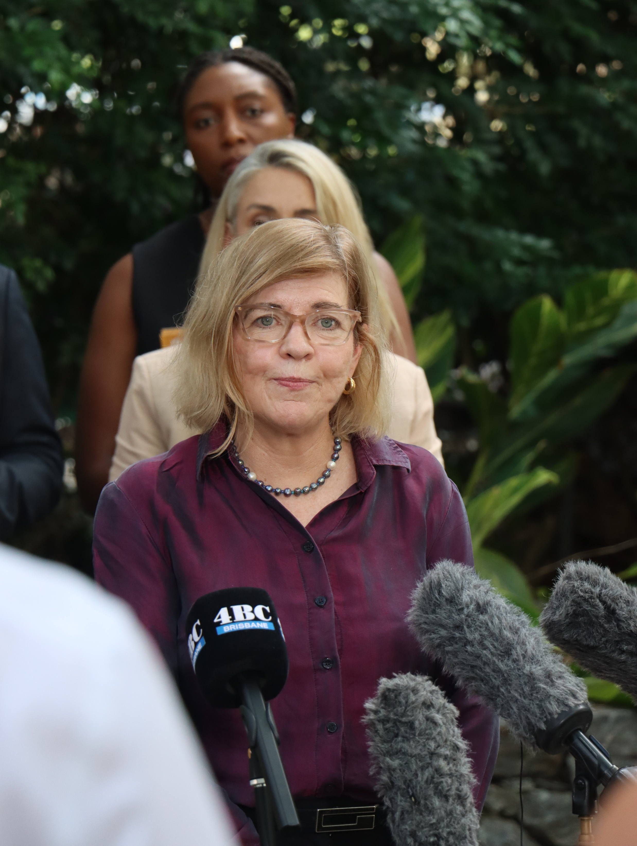
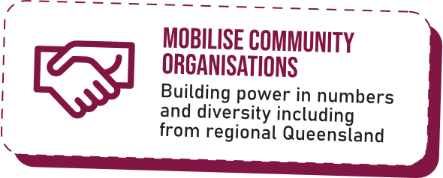
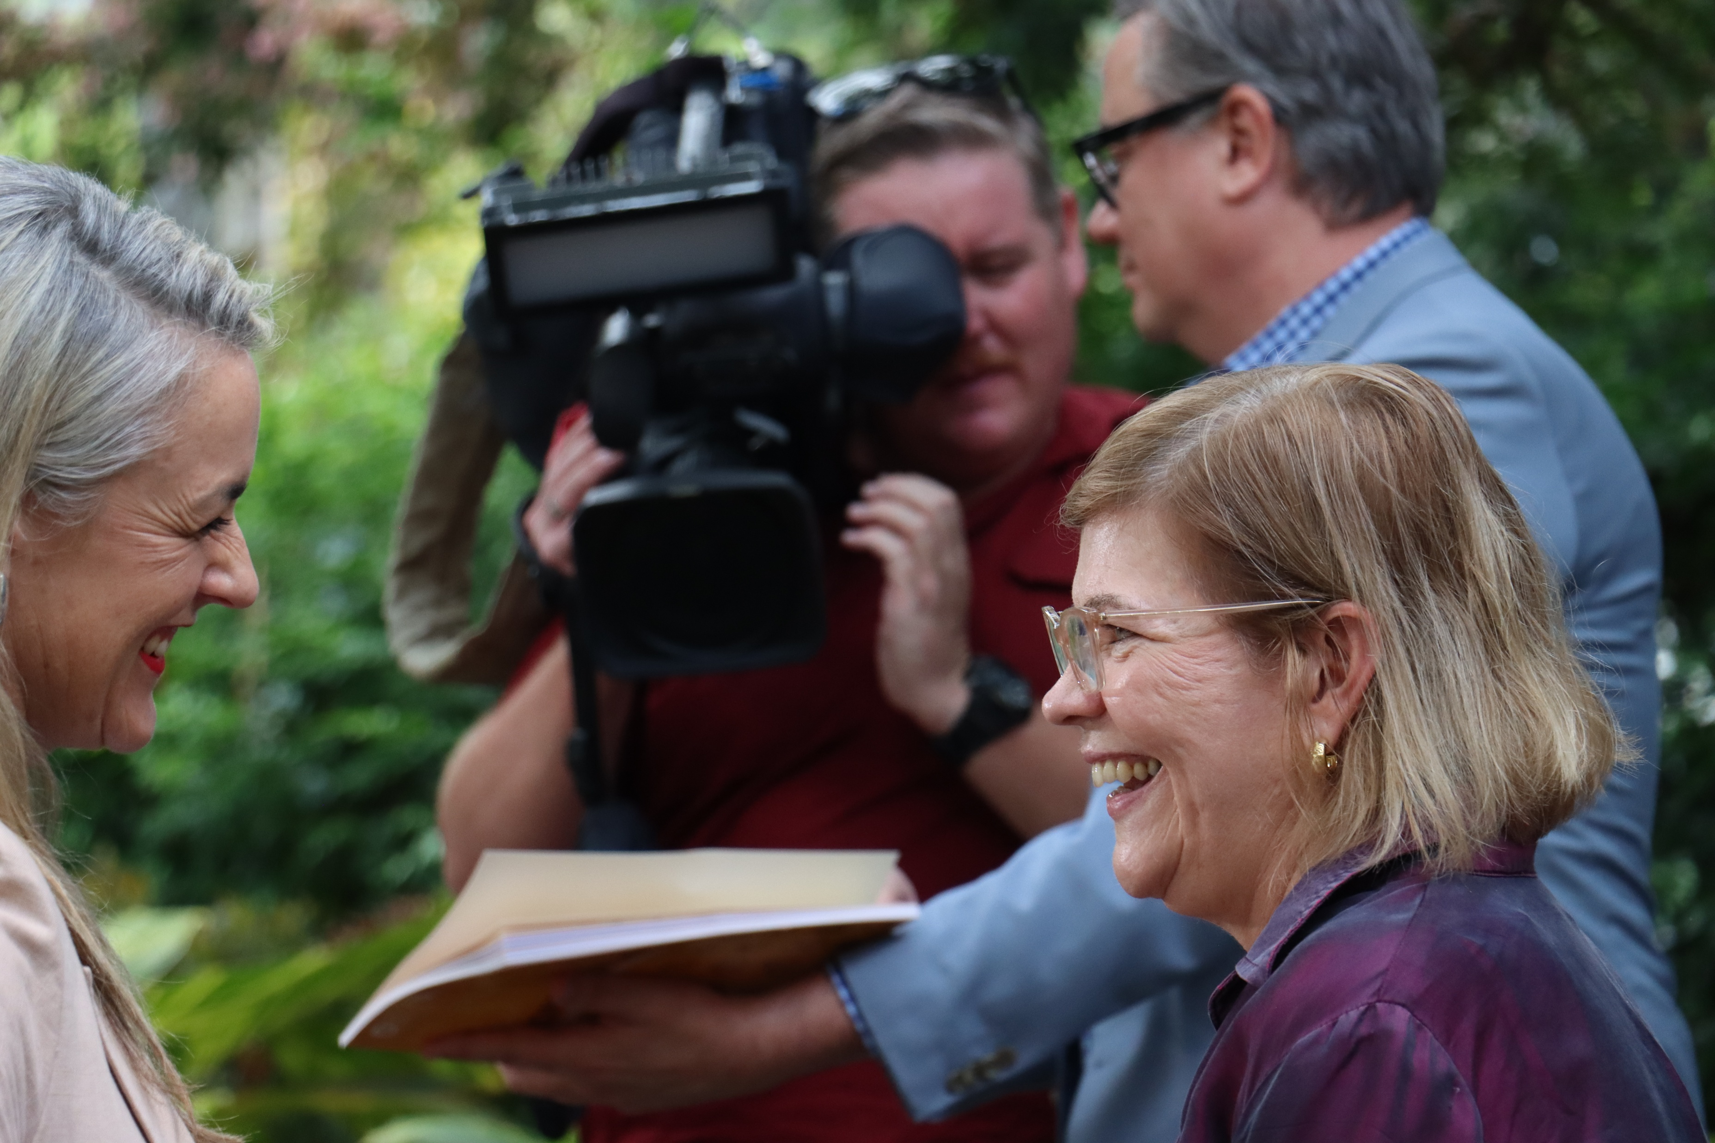
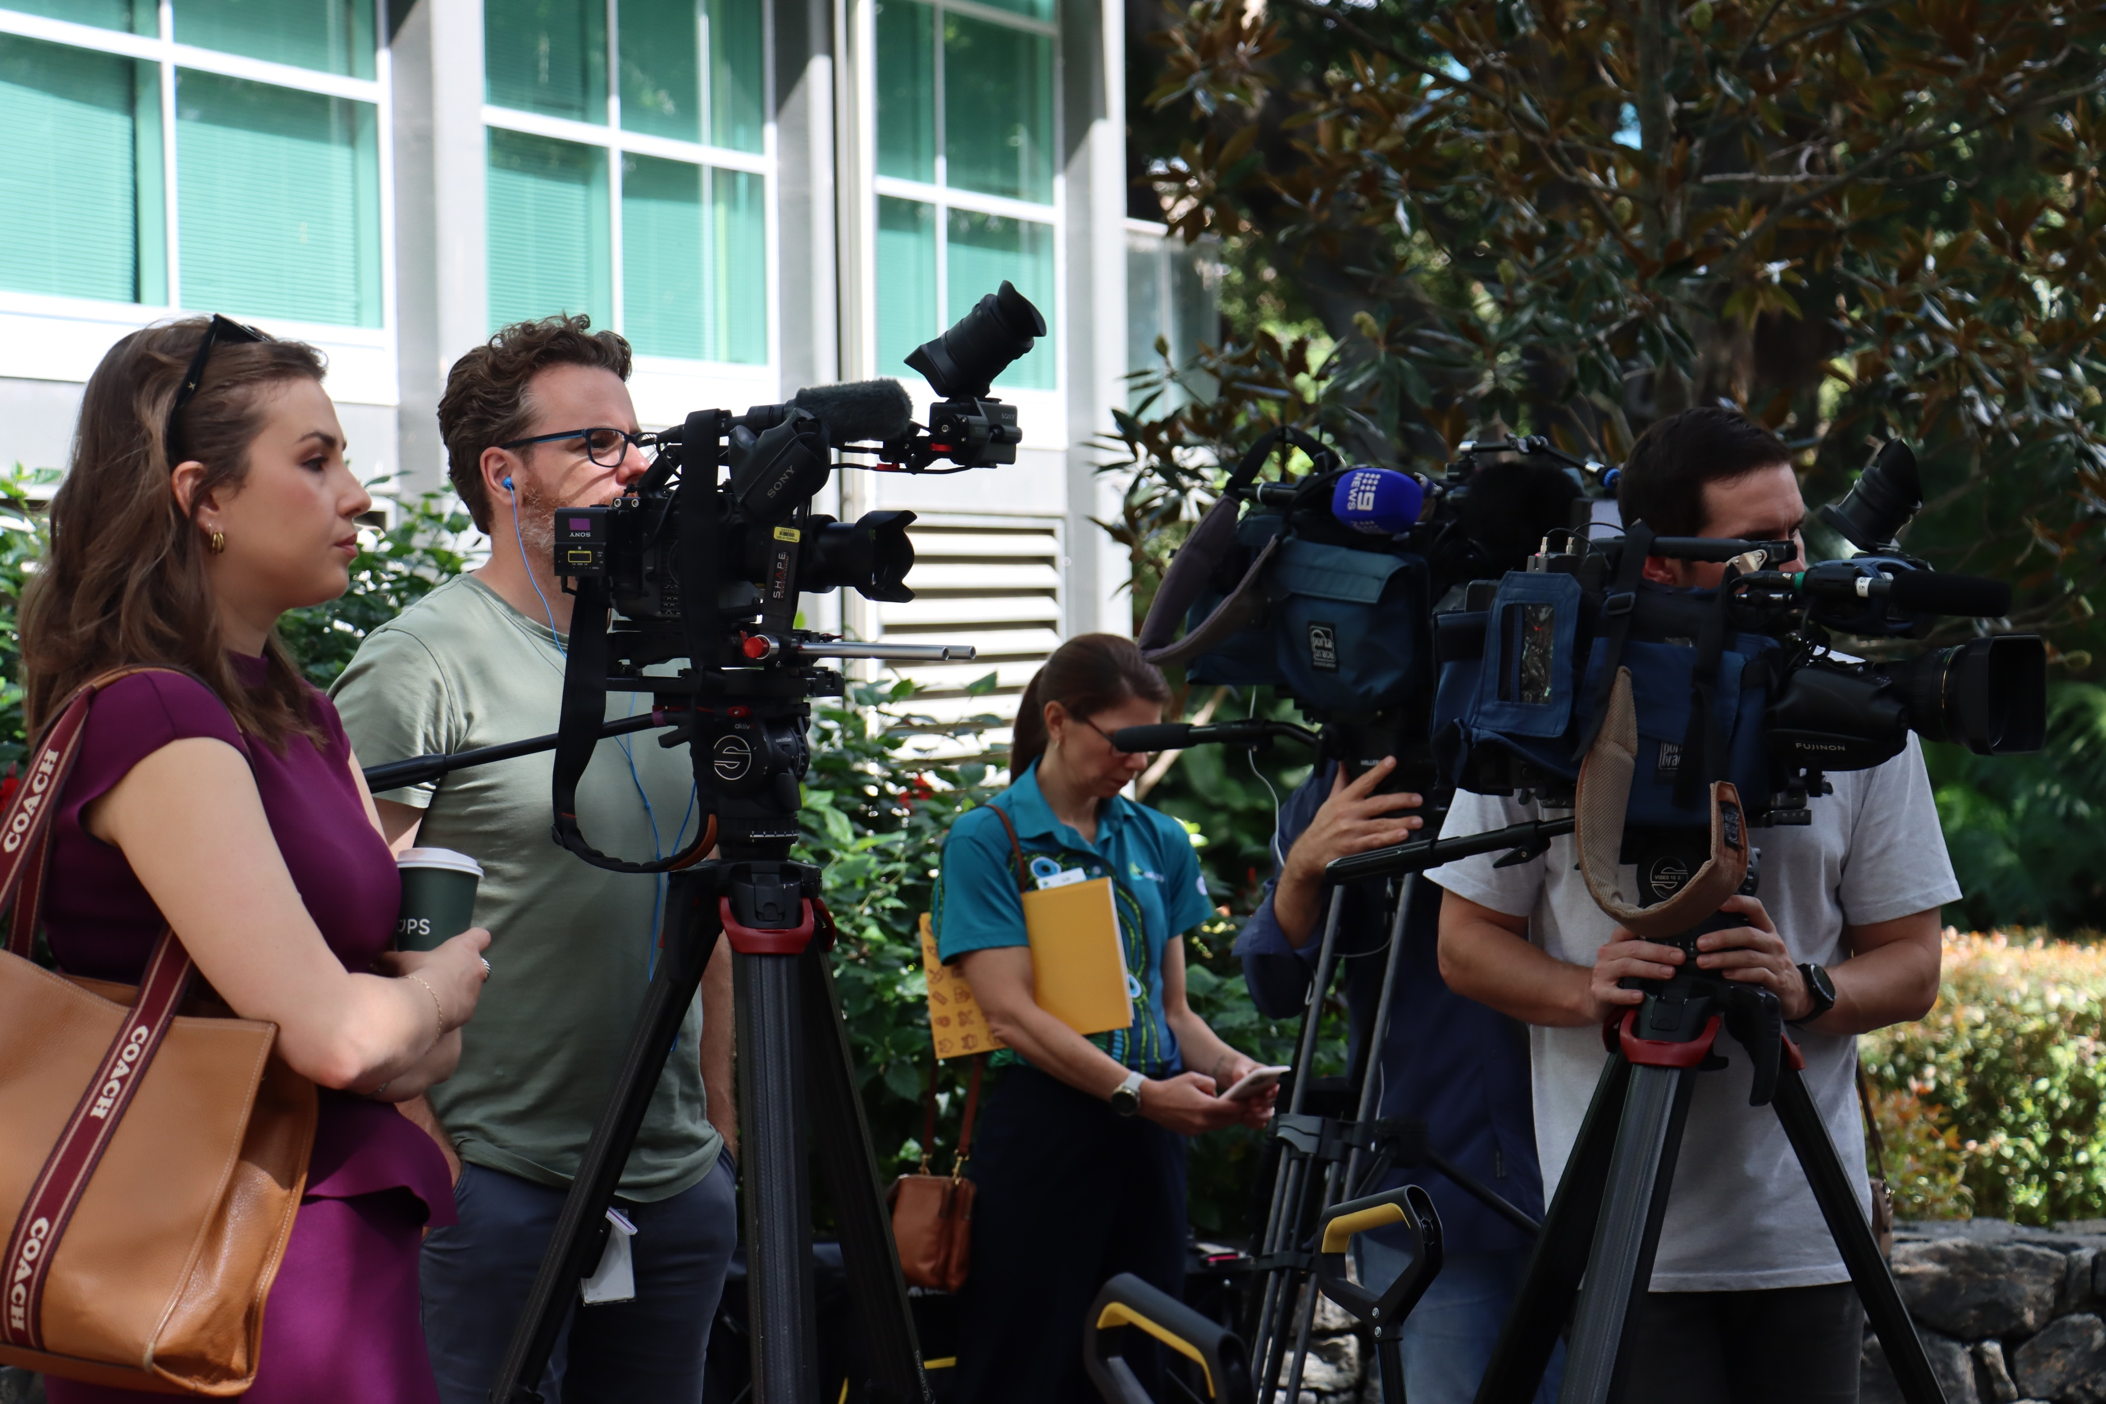

OUR APPROACH to systems change

Slide 20
Raising Queensland
Develop a whole-of-government Families strategy
Focus on secure housing for families
Ensure all Queensland’s kids are learning
Improve access to health services
Increase income support
Invest in community services that deliver for local communities

Slide 21

How to Get involved
Read the report Sign up to be part of Raising Queensland Share on social media Join QCOSS' Family and Child Policy Network Become a partner

Slide 22
